Slide 1
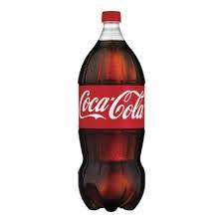
Renaissance Of Plastic Bottles !

Slide 2
Group 2 :Intelligent Idiots
Preskha Singla | BPIT , Delhi
J K Mani Sankar | IIITDM, Jabalpur
Arun Raj A S | SVCET , Chennai
Atishaya Kr. Saksham | IISC , Bangalore
(Clockwise)

Slide 3
When we buy products, We buy some unwanted wastes also.

Slide 4
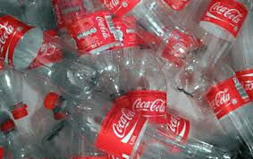

Slide 5
What happens to the plastic bottle after it’s been thrown into the dustbin?”

Slide 6
It gets picked-up, is sorted and then sent to a factory for recycling. Once re-cycled, it comes back as a new plastic bottle, with fresh and pure water. Neat, isn’t it?

Slide 7
But Unfortunately, no such thing happens.

Slide 8
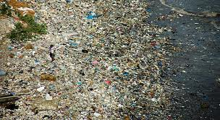
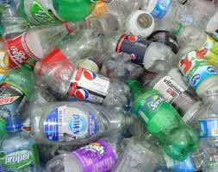
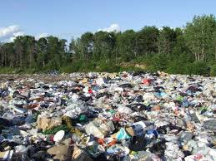
Only a fraction of these bottles actually get recycled. The rest simply go into landfills, adding to plastic waste.

Slide 9
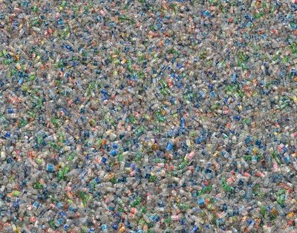
The Ultimate Result

Slide 10
By 2010, over 150 crores plastic water bottles in India ended in landfills. And this number is for water bottles alone ! This isn’t good news at all! Because, these plastic bottles don’t decompose. Even after 1000 years.

Slide 11
Some facts & figures..
Indian water bottle industry would have emitted an estimated 200,000 tonnes of CO2 and used more than 2.5 Lakh tonnes of oil in 2010.
Even if these bottles were recycled, the same amount of fossil fuels would have been used.
The plastic bottles leach toxic chemical called
Bisphenol which is known to cause cancer.
The chemical production increases when these water bottles are exposed to hot air temperatures.
Each year 17 million barrels of oil are used to make the plastic for the bottles – that’s enough to fuel 1 million cars for a year.

Slide 12
All plastic that is used for food and drink is brand new plastic. For health reasons we cannot use recycled plastic.
Each year 16.4 billion gallons of water are used to make the plastic – that’s not including the water used to fill the bottle.
Consumers often believe the coding symbols on plastic containers mean the item is recyclable. But in fact, the symbols only identify the resin base of the plastics, not all of which are accepted by all recycling programs.
80 % of our bottles are not recycled. They end up in the landfill or are incinerated with other trash.

Slide 13
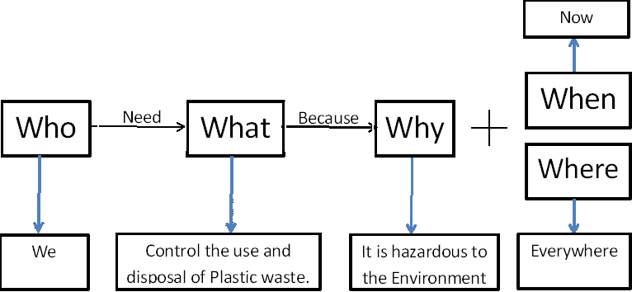
Problem Statement

Slide 14
Fish Bone Analysis

Slide 15
6 Thinking Hats
Blue : Hey guys we have to solve the issue of the
plastic waste as it is affecting our environment
White : By 2010, over 150 crores plastic bottles in India ended in landfills.
Red : Yes this will turn into a huge problem for the living of future generation.
Green : What if the used plastic bottles are recycled?
Yellow : Yes, the used plastic bottles can be picked up, sorted, sent to the factory for recycling.
Black : No, it is not possible because recycling will need lot of oil and it too produces other waste which will effect environment.

Slide 16
6 Thinking Hats Cont…
Green : How about remoulding the plastic bottles and reusing them for different purposes.
Yellow : Yeah, that’s a good idea. It doesn’t effect the environment and plastic used for making containers can be reduced.
Black : (Silent and unable to contradict).
Blue : So, lets remould the plastic and use it for different purposes.

Slide 17
Pareto’s Analysis
Plastics (PET) are used for making various products like bottles, boxes, sheets, stationary and toys.
But beverage bottles and boxes are among major PET products.
On a rough estimate, 80 % of the PET polymer is used to produce only 20 % of the total PET products like coke and water bottles.
So it’s a major issue to pay attention at the proper management and disposal of these bottles.

Slide 18
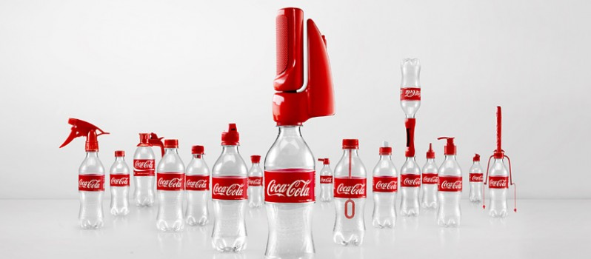
Most often we use coke bottles for storing water.
In garden, it is used as water sprinklers.
Interestingly, Coca Cola has launched 16 new bottle caps that transform coke bottles into useful things.

Slide 19
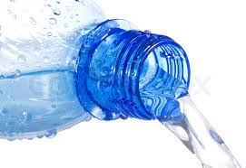
But all these tricks work upon liquids only, which can flow easily through the narrow end.

Slide 20
What else can we DO ?

Slide 21
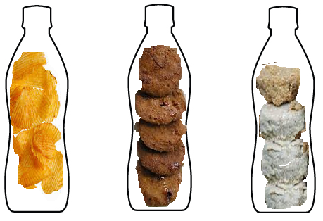
What if we can store Solids in such plastic bottles ?

Slide 22
Yes, Of course we can do it. You just have to apply your creativity.

Slide 23
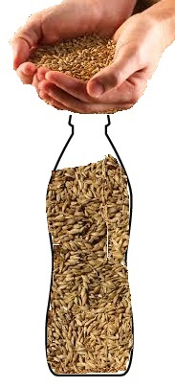
How is it ??

Slide 24
But is this really a GOOD IDEA ?

Slide 25
A big NO !

Slide 26
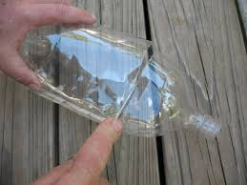
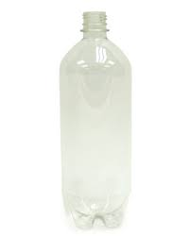
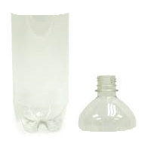
Our Idea !!

Slide 27
Then, Remould the two parts using heat treatment to give it a threading or finish so that they can spiral into each other.

Slide 28
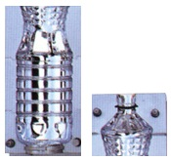
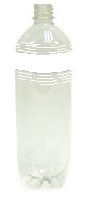
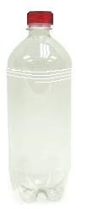

Slide 29
Advantages
Reuse is better than recycling, as recycling requires energy and resources.
It would ensure proper disposal of plastic bottles.
It can be tough and durable container.

Slide 30
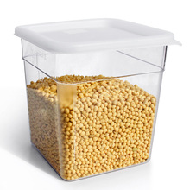
Probable Applications..

Slide 31
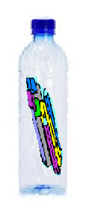
Probable Applications..

Slide 32
Probable Applications..
And Many Others..
Like waterproof product packaging.
Attractive transparent gift packing, etc.

Slide 33
Why it should be considered ?
Impact :
It will ensure the proper disposal of plastic bottles
Limit the production of other plastic materials.
Market :
Huge market for it, as bottles are present everywhere. So it can be moulded and sold anywhere.
Competition :
No competition if the price of moulding is much cheaper than producing a new comparable size container.

Slide 34
Implementation Requirements..
Financial Help : Capital for making moulding machines.
Marketing Help : for collection of used the bottles and distribution of the products.

Slide 35
Other Thoughts We had !
Regenerative Brakes in Bicycles.
Electric Wire Mesh for windows.
Domestic Organic Waste Recycler.

Slide 37
References
GROWTH OF PLASTIC INDUSTRY IN THE COUNTRY, CIPET, India
About Plastic Smiles And Bottles Water, The Viewspaper, Published January 7th, 2011.
The Life Cycle of a Plastic Bottle, montgomery school.
2011 UNITED STATES NATIONAL POSTCONSUMER PLASTICS BOTTLE RECYCLING REPORT.

